Slide 1
Binding and
Data Types
Abhijit A M
abhijit.comp@coep.ac.in

Slide 2
Binding

Slide 3
Binding
Binding = establishing a relationship (between two things)
  Also “making a choice from a set of available choices”
X = 5
  Binding the value 5 to the variable X

Slide 4
Various possible bindings
X = X + 10
  Set of available types for X
  The particular data type chosen for X
  Set of possible values for X
  The particular value for X
  Representation of “10” (how many bits, order of bits, etc)
  Meaning of + , =
  ...

Slide 5
Various possible binding times
Language Design time
  Some things are decided by language designers, for example the syntax
Language Implementation time
  Some things are decided while writing the compiler or interepreter, for example, how to evaluate expressions is decided by compiler

Slide 6
Various possible binding times
Translation time (Compilation or Interpretation)
  By the programmer
    Names of variables, …
  By the compiler
    Actual in memory order of various variables
Linking time
  Code of printf() with the call to printf()
Loading Time:
    Actual memory location of the program and the data objects
Run time
  Value of a variable

Slide 7
Various possible bindings in C and Python
X = X + 10
  Set of available types for X: lang definition time, lang definition time
  The particular data type chosen for X: translation time, run time
  Set of possible values for X: translation time, lang. Definition time
  The particular value for X: run time, run time
  Representation of “10” (how many bits, order of bits, etc): translation time, translation time,
  Meaning of + , = translation time, run time

Slide 8
Importance of Binding Times
Depending on “when” the decision of binding is taken, the languages differ from each radically
Languages in which most bindings happen during or before translation are called “early binding” languages
Languages in which most bindings happen after translation are called “late binding” languages
“Early Binding” languages are normally compiled and “Late binding” languages are normally interpreted

Slide 9
Importance of Binding Times
In python the type of a variable is determined at Run time, in C at translation time.
  So python is “late binding” while C is “early binding” language.
Python is interpreted, while C is compiled.
Can we write a compiler for python? If yes, then why it is not written ?

Slide 10
Cost of “late binding” with compilation
Need to generate m/c code that will remember the type of each variable
Need to generate m/c code which will check if an operation is supported on that type
Type determination code itself will have some “cost” , slowing the program
The generated object code will be bulky also (more disk space)
Writing the compiler, which generated complex code like this, will also be a difficult task

Slide 11
Cost of “early binding” with interpretation
The interpreter itself is a program which is always running
  So your program and the interpreter are both running
  So interpretation is inherently slow
Early binding means, most of the meanings are known before translation
  So why not take care of those during translation and just run the program's code while execution
  Interpretation will be an additional cost now

Slide 12
Data Types
What does the compiler do with the data type ?
Some definitions from the literature
Various data types that languages provide
What is done by the hardware and what is done by the compiler

Slide 13
Let's start with some Definitions
A data object is a container for data.
  programmer defined
    variables, constants, arrays, files
    can be defined and manipulated explicitly
  system defined
    stack, activation records, file buffers. free-space lists
    are not directly accessible to the programmer
    THERE IS SOME ADDITIONAL CODE GENERATED BY THE COMPILER !!
Elementary data objects are manipulated as a unit.
Data structures are aggregates made up of other data objects.

Slide 14
Data Object Properties
Attributes are generally fixed for the lifetime of the object, bindings may change.
  E.g. student has attributes age, year. Binding of age to “21” and year to “sy” or “ty” keeps changing.
  Some attributes are used only by the translator; some are stored in a descriptor (dope vector) for use during execution.

Slide 15
Data Object Properties
lifetime (extent) – the period of time during program execution during which the data object exists
type – determines the set of values the object can have
storage location
value
name – used to reference the object, an object may have multiple names
component – binding a data object to another object of which it is a part

Slide 16
Data objects
Scalar data objects:
  Numeric (Integers, Real)
  Arrays
  Booleans
  Characters
  Enumerations
  Pointer (what it points to is often composite)
Composite objects
  String
  File
Structured objects
  Records
  Lists
  Sets
Abstract data types
  Classes
Active Objects
  Tasks
  Processes

Slide 17
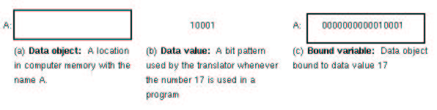
What is a Variable ?
A variable is a binding of a name to a memory location
  Contents of the location may change

Slide 18
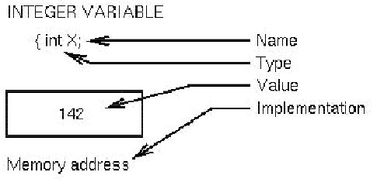
Variables
A variable is a data object that is defined and named by the programmer.

Slide 19
Constants
A constant is a name bound to a value
  a literal constant has a name which is its value
  a manifest constant is named by the programmer
  #define MAX 10
  main() { const int j = 10; int k
  k = MAX; k = j; }
Since a constant can’t change, its value is known to and can be used by the compiler
  A constant could be bound at compile time

Slide 20
Data Types
A data type is a class of data objects along with the operations that can be used to created and manipulate them.
Primitive types are defined as part of the language specification and implemented with the language. e.g. int, float, etc. in C
Most modern languages allow the programmer to define new types, e.g. typedef struct stack { .. } stack;
  Object-oriented languages allow the programmer to define the operations as well.

Slide 21
Data types
Each data type is defined by the following information:
  Attributes: (e.g., name, data type)
  Values: range of allowed values
  Operations: possible manipulations for the data type
    Textbook Notation for Signatures of operations: f : type × type − > type pow: int x int → float
A data type is implemented by choosing
  storage representation (data structure)
  algorithms for implementing the operations

Slide 22
Specifying Operations
Operations can be built-in or programmer specified.
An operation should be a mathematical function
  should have a unique output for every possible input.
Difficulties in specifying operations as mathematical functions
  The result may be undefined for some inputs – x / 0 e.g.
  There may be implicit arguments
  int x; int f(int y ) { return y * x;}
  There may be side effects – modification of parameters e.g.
  int i; int f(int x) { i = x*x; return i; }
  Self Modification: The result may depend on previous calls to the same operation, use of static in C

Slide 23
Implementation of Elementary data types
Storage
  Depends on the hardware
  Usually using hardware primitives
Attributes
  Many times determined by compiler, e.g. C
  Stored as run time descriptor, LISP
Operations
  Next slide

Slide 24
Data type implementation
Implementation approaches for operations
  use underlying hardware operations
  c = a + b (uses hardware add instruction)
  write function or procedure
  MyInteger add(MyInteger a, MyInteger b) {...}
  inline code sequence - replacement of function call with the body of function
  C++
  inline MyInteger add(MyInteger a, MyInteger b)

Slide 25
Assignment operation
Assignment is a special type of operation
  its primary effect is to change the binding of a value to a data object
There are two common signatures for this operation:
1. Pascal: Integer × Integer − > void
2. C/C++: Integer1 × Integer2 − > Integer3
Thus a C assignment operation can be reused
(c = getchar()) != '\n')

Slide 26
Where did names L-value and R-value come from?
Consider executing: A = B + C;
  Pick up contents of location B
  Add contents of location C
  Store result into address A.
For each named object, its position on the right-hand-side of the assignment op-erator (=) means content-of location,
and its position on the left-hand-side of the assignment operator means an address-of location.

Slide 27
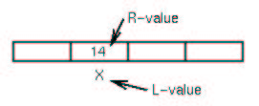
Where did names L-value and R-value come from?
  address-of means L-value
  Contents-of means R-value
  Value, by itself, generally means R-value

Slide 28
What does the translator do with the types ?

Slide 29
Type Checking
Checking each operation received the proper number of arguments of proper type
  X = A + B * C
  What is type of A , B, C ?
  Can they be operated upon by + * ?
  Can the result be assigned to X ?
  If A is array and B is integer → then error in C
One of the most important issues that distinguishes between language types

Slide 30
Type Checking
Static Type Checking
  Type checking done at compile time
  Compiler should know the types for all variables
  C, Pascal, Java
Dynamic Type checking
  Type checking done at run time
  The “run time system” – interpreter – which may be a software of hardware (i.e. processor) should know about type
  Store information about type with the variable, usually in a “tag”
  Perl, python, prolog,...

Slide 31
Dynamic Type Checking
+ Flexibility on programming
+ No declarations needed
- Difficult to debug
  Unexecuted paths never type checked
- Type info to be stored at run time
- Normally software interpreted, so slow

Slide 32
Static Type Checking
Compiler needs info: about type of each variable, for each operation the signature, type of each constant
During syntax analysis collects type info in Symbol Table
+ More efficiency – no run time additional code
- Less flexibility
- Not possible for some constructs of languages

Slide 33
Strong Typing
If all type errors can be checked statically
F: S → R is type safe if all results are in the domain of R
  short X, Y; X+ Y may overflow , so not type safe
Difficult to achieve 100% strong typing

Slide 34
Type Inference
Compiler “infers” the type of a variable
Language ML has this feature
  Infers missing type from other variable's types
fun area(length, width):int = length * width
fun area(length:int, width) = length * width
fun area(length,width:int) = length * width
fun area(length,width) = length * width → INVALID

Slide 35
Conversion between types:
Given 2 variables A and B, when is A:=B legal?
Explicit : All conversion between different types must be specified
Implicit : Some conversions between different types implied by language definition

Slide 36
Conversion examples
Examples in Pascal:
var A: real;
B: integer;
A := B – Implicit, called a coercion - an automatic conversion from one type to another
A := B is called a widening conversion since the type of A has more values than B.
B := A (if allowed) is a narrowing conversion since B has fewer values than A. Information could be lost in this case.
B := (int)A – Explicit, called a cast

Slide 37
Coercion
In most languages widening coercions are allowed; narrowing coercions usually must be explicit.
  This is true in Java
In addition to casting, there are often functions that can be used for conversion.
  B := round(A); Go to integer nearest A
  B := trunc(A); Delete fractional part of A

Slide 38
Now let's examine some data types … their specification (what the users can do with them) and implementation (the way the translator handles them )

Slide 39
Integer numeric data
Integers: Binary representation in 2’s complement arithmetic
For 32-bit words:
  Maximum value:
    2³ ¹ − 1
  Minimum value:
    −2³ ¹

Slide 40
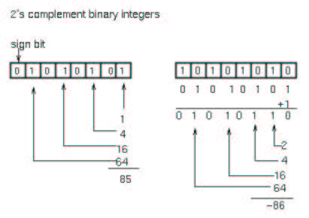
Integer numeric data

Slide 41
Converting integers to binary
I hope you already know how to do this !

Slide 42
Integer operations
Arithmetic
  Binary: addition, subtraction, multiplication, division, modulo + - * / %
  Unary: negation, identity -
Relational: less, greater, equal, not equal, Assignment < > = != =
Bit Operations: AND, OR, shift & | << >>

Slide 43
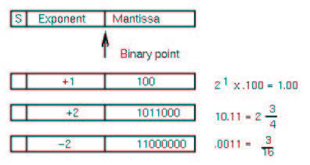
Real numeric data
Floating Point (real): hardware representations

Slide 44
Real numeric data
Exponents usually biased e.g., if 8 bits (256 values) +128 added to exponent
  so exponent of 128 => 128 − 128 = 0 is true exponent
  so exponent of 129 => 129 − 128 = 1 is true exponent
  so exponent of 120 => 120 − 128 = −8 is true exponent

Slide 45
IEEE floating point format
IEEE standard 754 specifies both a 32- and 64-bit standard.
Numbers consist of three fields:
  S: a one-bit sign field. 0 is positive.
  E: an exponent in excess-127 notation. Values (8 bits) range from 0 to 255, corresponding to exponents of 2 that range from -127 to 128.
  M: a mantissa of 23 bits. Since the first bit of the mantissa in a normalized number is always 1, it can be omitted and inserted automatically by the hardware, yielding an extra 24th bit of precision.

Slide 46
Example floating point numbers
+1 = 2⁰ ∗ 1 = 2¹²⁷⁻¹²⁷ ∗ (1).0b
  0 01111111 000000...
+1.5 = 2⁰ ∗ 1.5 = 2¹²⁷⁻¹²⁷ ∗ (1).1b
  0 01111111 100000...
−5 = −2² ∗ 1.25 = 2¹²⁹⁻¹²⁷ ∗ (1).01b
  1 10000001010000...
This gives a range from 10⁻³⁸ to 10³⁸ .
In 64-bit format,the exponent is extended to 11 bits giving a range from −10²² to +10²³, yielding numbers in the range 10⁻³⁰⁸ to 10³⁰⁸ .

Slide 47
Decoding IEEE format
Given E, and M, the value of the representation is:
  (−1)S × (1 + Mf ) × 2(E−128)
where Mf is a fractional value.
Parameters Value
E = 255 and M != 0 An invalid number
E = 255 and M = 0 ∞
0 < E < 255 2E−127 1.M
E = 0 and M != 0 2E−126 .M
E = 0 and M = 0 0

Slide 48
Floating Point Operations
Converting real numbers to binary
Usual arithmetic and comparison operations – implemented in hardware if possible
Built-in mathematical functions – sin, sqrt, etc

Slide 49
Fixed point data
Fixed decimal in PL/I and COBOL (For financial applications)
  DECLARE X FIXED DECIMAL(p,q);
  p = number of decimal digits
  q = number of fractional digits
Example of PL/I fixed decimal:
  DECLARE X FIXED DECIMAL (5,3),
  Y FIXED DECIMAL (6,2),
  Z FIXED DECIMAL (6,1);
  X = 12.345;
  Y = 9876.54;

Slide 50
Using decimal data
What is Z=X+Y?
  X = 12.345;
  Y = 9876.54;
By hand you would line up decimal points and add:
  0012.345
  9876.540
  9888.885 = FIXED DECIMAL(8,3)
p=8 since adding two 4 digit numbers can give 5 digit result and need 3 places for fractional part.
p=8 and q=3 is known before addition. Known during compilation - No runtime testing needed.

Slide 51
Implementing fixed decimal data
Algorithm for code generation by compiler:
Store each number as an integer (12345, 987654)
  Compiler knows scale factor (S=3 for X, S=2 for Y) and remembers it
  True value printed by dividing stored integer by 10^{S}
To add X+ Y, align decimal point. Adjust S by 1 (=3-2) by multiplying by 10.
10*Y+X = 9876540 + 12345 = 9888885, Compiler knows S=3

Slide 52
Other numeric data
Short integers (C) – 16 bit, 8 bit
Long integers (C) – 64 bit
Byte – 8 bits
complex – requires two data values
rational numbers – quotient of two integers

Slide 53
Enumerations
Enumerated types allow the programmer to specify types which can take on a limited number of symbolic values.
  typedef enum thing {A, B, C, D} NewType;
  typedef enum color { orange, red, white } color ;
Implemented as small integers with values:
  A = 0, B = 1, C = 2, D = 3; orange = 0, red =1, white= 2; etc
  NewType X, Y, Z; color a, b, c;
  X = A; a = b;
Why not simply write: X=0 instead of X=A?
  Readability a =0; Vs a = orange ?
  Error detection a= 4; // improper, but legal

Slide 54
Enumeration Example
In Pascal:
  enum { fresh, soph, junior, senior} ClassLevel;
  enum { old, new } BreadStatus;
  BreadStatus = fresh; An error which can be detected
Defining an enumerated type effectively gives you a set of named constants.
In C and C++, you could use an enumerated type for your lexeme types.

Slide 55
Character
Representation
  Single 8-bit byte can represent up to 256 characters
  ASCII is a 7 bit 128 character code
  Unicode (Java) is a 16-bit code
In C, a char variable is simply 8-bit integer numeric data
  usually supported in hardware
  Operations – relational, class membership (isdigit e.g.)

Slide 56
Boolean
Value true or false
Could use 1 bit for storage efficiency
Frequently use byte or word for efficiency
  use a particular bit
  use 0 for true, everything else for false
Operations: and, not, or
Not supported in C

Slide 57
Boolean Implementation
Could implement as single bit but usually use smallest addressable memory
  unit (byte or word) for efficiency
  values of true and false
    defined values of true and false as in java
    use state of a specific bit
    use 0 for false; anything else is true – have to be careful since complement of a true value may not be false

Slide 58
Subtypes
A is a subtype of B if every value of A is a value of B.
A subtype shares the operations of the type it was derived from.
  Pascal allows the programmer to define subranges of integers
type SmallInteger = 1..20;
  In Java, byte and short are subtypes of integer - they don’t have a separate set of operations defined
  In C almost everything (except floating point) is a subtype of integer.
Subranges have smaller storage requirements and better type checking but generally slower operations.

Slide 59
Bitstrings
Combine multiple data values into a single storage unit
  one byte could hold 8 independent bits of information
Allow multiple boolean values to be packed into smaller space
Harder to use because of having to extract bits individually
struct x {
int x:2;
int y:5;
}y;
main() {
y.x = 1;
}

Slide 60
Composite data
Character Strings: Primitive object made up of more primitive character data.
Fixed length
  char A(10) - C
  DCL B CHAR(10) - PL/I
  var C packed array [1..10] of char - Pascal
Variable length: upto alimit
  DCL D CHAR(20) VARYING - PL/I - 0 to 20 characters
Variable length: no limit
  E = "ABC" - SNOBOL4 - any size, dynamic

Slide 61
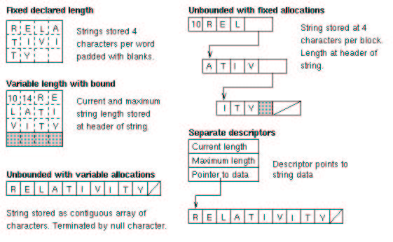
String implementations

Slide 62
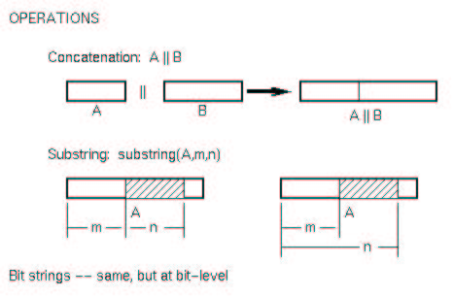
String operations
Concatenation
Comparisons – based on encoding
Substring – based on either position or pattern matching

Slide 63
String operations
Special case of C:
  F = "ABCDEFG" - C - size programmer defined, terminated by null character ’\0’, can't change later
  char a [10];
  In C, arrays and character strings are the same. Except, the last element of a character string must be ’\0’.
Implementation of element access:
  L-value(A[I]) = L-value(A[0]) + I

Slide 64
Pointer data
Data object whose value is a location
  pointers may reference a single type as in C, Pascal, Ada
  pointers may reference any type as in Smalltalk
  object-oriented languages use a mixture
Use of pointers to create arbitrary data structures such as linked lists
  malloc ( C) or new (C++)

Slide 65
Pointer data
In general a very error prone construct and should be avoided – memory leaks, dangling pointers
Some languages allow the programmer to manipulate pointers directly – C, C++
Other languages hide pointers in the implementation – Java
Implementation – either absolute or relative address possible

Slide 66
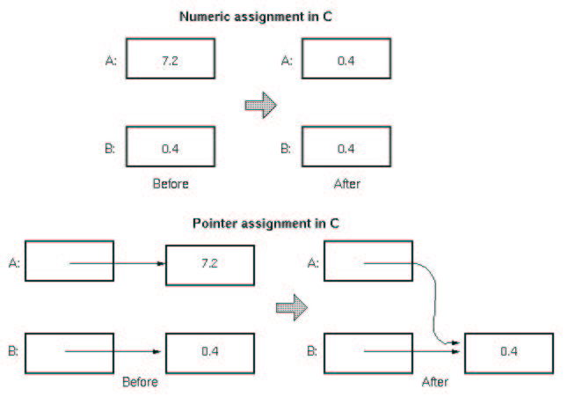
Pointer aliasing

Slide 67
Pointer Operations
Creation (new, malloc) – allocate memory for a data object for the pointer to refer to
dereferencing – retrieve the data that a pointer is refering to
deletion (delete, free) – free up the memory used by the object a pointer is refering to

Slide 68
EXTRA SLIDES

Slide 69
Files
A special kind of data object
  represented in secondary memory (disk)
  lifetime extends beyond that of the program
  used for I/O and scratch storage
Three types
  sequential – variable length, linear sequence of components of the same type, usually characters
  direct access – unordered sequence of components each of which can be accessed at random
  indexed sequential – like direct access except components are ordered by key value
Operations: open, read, write, check for EOF, close
Implementation: generally based on the file system of the OS

Slide 70
Declarations
Declarations serve several purposes
  determines storage requirements
  ocation in program determines variable lifetime which is used for storage management
  allows translator to choose between polymorphic versions of an operation
  facilitates type checking
  initialization (usually optional)
  storage representation in a few languages (COBOL)
Some languages require explicit declarations – C, C++, Java
Other languages allow implicit declarations – variables beginning with [I..N] are
integer by default in Fortran
Some languages don’t have types – Perl
Some languages can infer types from the context – ML

Slide 71
Type Inference
Consider
  x = 3 * 5
x must be an integer because the result of the operation is an integer
  float y = a + 3.0
a must be a float because the operation needs two arguments of the same type

Slide 72
Declarations for Programmed Defined Operations
Prototypes or declarations are often used to give the signature
  return type
  number of arguments
  order of arguments
  type for each argument

Slide 73
Type Checking
A value stored in hardware is just a sequence of bits. It could represent anything – integer, floating point number, characters, instruction. In order to interpret the bits, the type needs to be known.
Type checking is used to determine whether operations (or functions) have correct number and type of arguments can be static or dynamic
  Static type-checking done at compile time. It is more efficient. A symbol table is used to store the information needed by the compiler for each data object - type for variables, type and value for constants, argument number, order and types as well as return type for functions.
  Dynamic type-checking is done at execution-time. It is less efficient, both in speed and memory, can make things hard to debug but is more flexible. A type-tag needs to be stored along with the value(s) for each data object.
Many languages have situations where static type-checking is not possible.(Superclass references in Java for instance.) Can use either dynamic type checking or leave these situations unchecked.
A strongly-typed language is one in which all type-checking can be done at compile time

Slide 74
Batch Model of Processing
Many program executions can be viewed as consisting of the following steps:
program loaded
access to external data (files) made available to program
program executes
program terminates
Not all processes fit this model – think about an airline reservation system, Bron-coWeb, on-line banking
Both data and program co-exist indefinitely.

